Slide 1
ClassLog
Your AI-Powered Teaching Assistant
Group 4

Slide 2
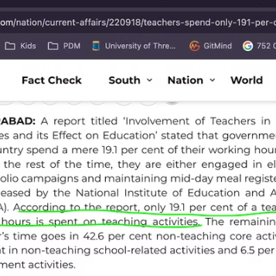

Market research

Slide 3
Problems of a teacher
"Teachers often spend a significant portion of their time on administrative tasks. This reduces the availability of time for lesson planning, creating class notes, analysis of class and creating quizzes.This administrative workload hampers their ability to focus on personalized instruction and enhances burnout, ultimately affecting the quality of education."

Slide 4
Product Vision
“Our product empowers teachers to automate generation of lesson planning, class transcription, lecture video analysis and quiz generation. We help educators reclaim time by enabling them to focus more on teaching and engaging with students through streamlined automation and intelligent tools.”

Slide 5
Feature List
Dynamic Lesson Plan Generation
Lecture Notes Generation
Quiz Generation
Lecture Video Analysis

Slide 6
Workflow

Slide 7
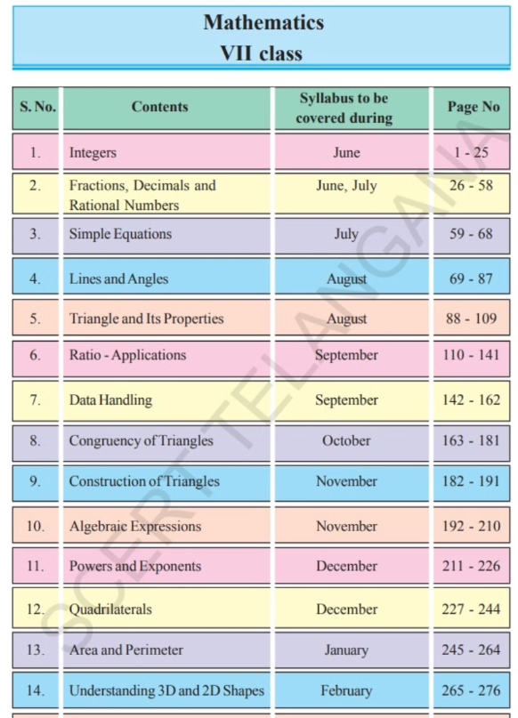
Screen print of a Textbook ToC

Slide 8
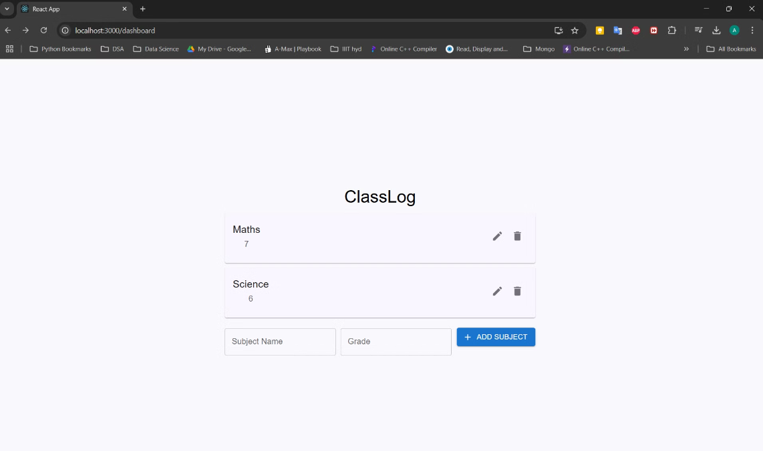
Teacher can Add, Remove & Edit Subjects
on the Dashboard
Notes:
This slide provides an overview of the intuitive ClassLog workflow, from lesson creation to student feedback. The workflow consists of three key stages: lesson creation, lecture analysis, and student feedback. In the lesson creation stage, you can leverage ClassLog's dynamic lecture plan generation to create engaging lessons tailored to your students' needs. The lecture analysis stage offers real-time insights into your teaching performance, using ClassLog's comprehensive analysis tools. The student feedback stage allows you to collect and analyze feedback from students, enabling you to continuously improve your teaching methods and enhance the learning experience. The clean, minimalist illustration on the slide helps visualize this seamless workflow.

Slide 9
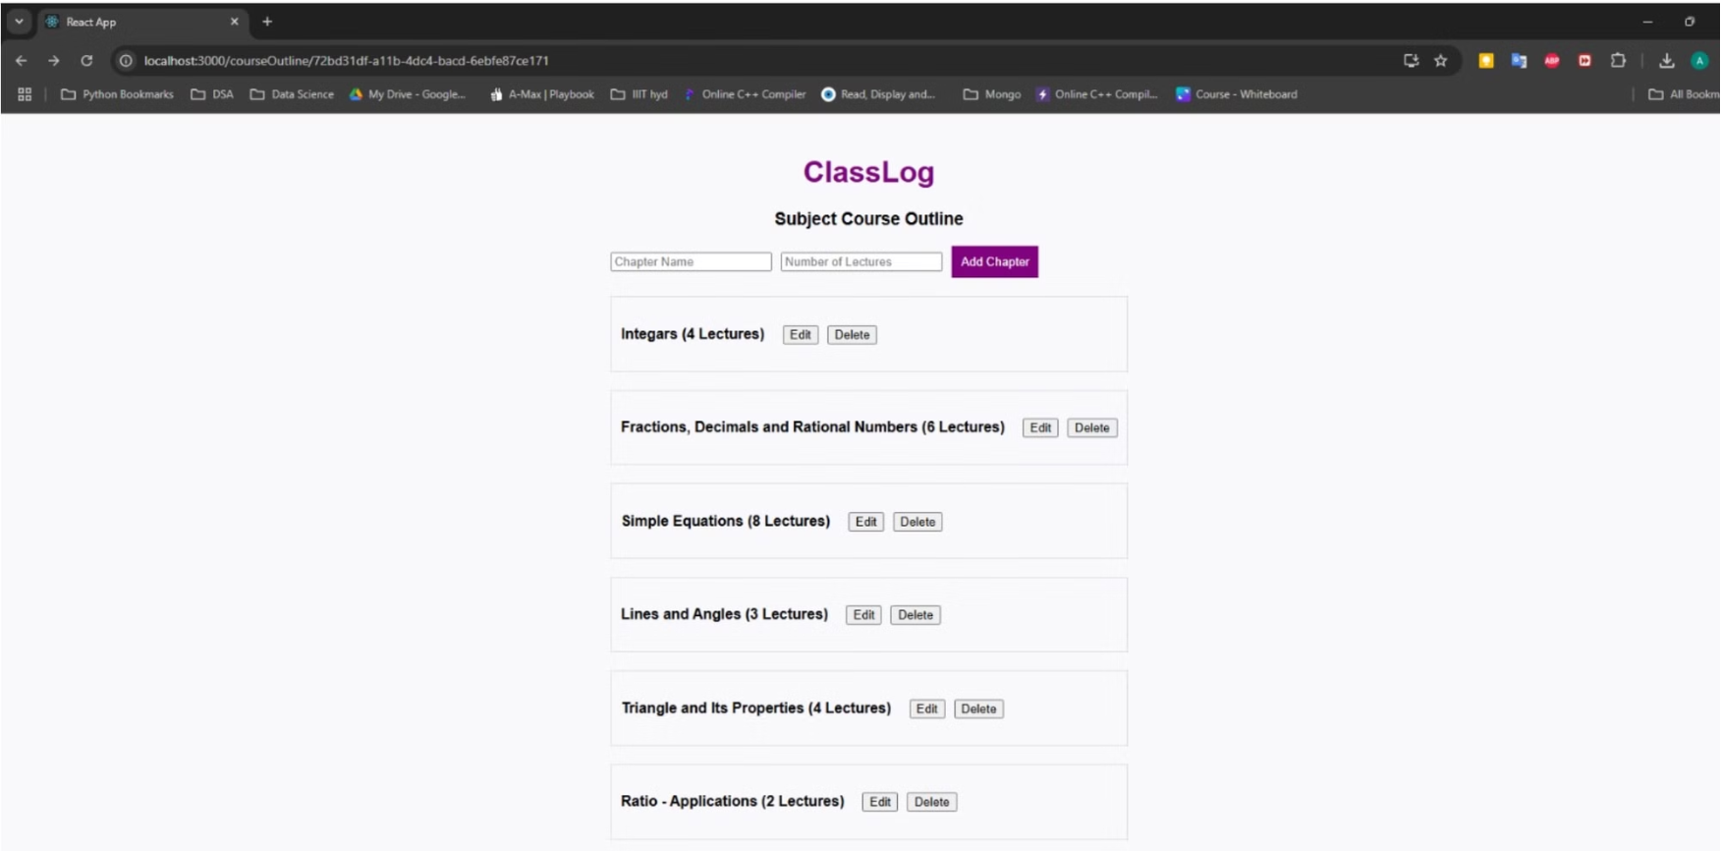
Chapters of a subject

Slide 10
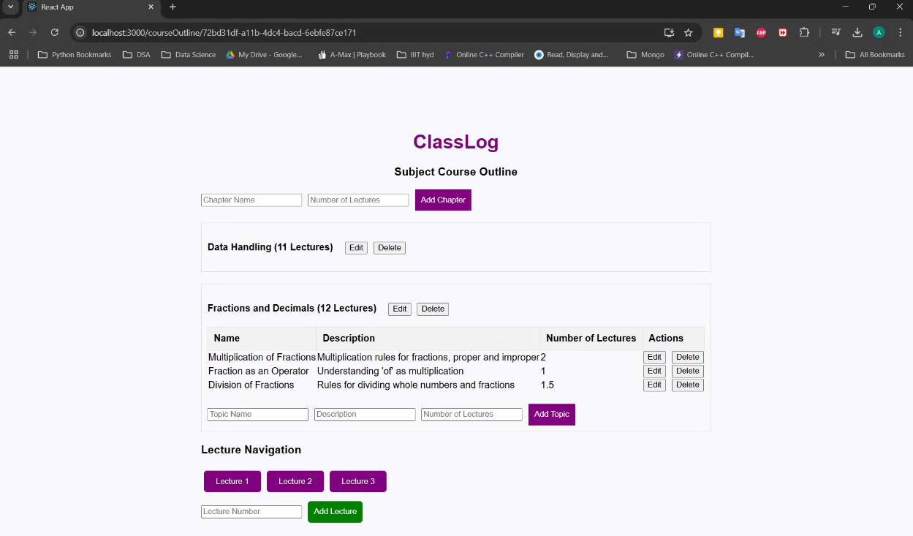
Add & manage
Chapters
Notes:
This slide provides an overview of the intuitive ClassLog workflow, from lesson creation to student feedback. The workflow consists of three key stages: lesson creation, lecture analysis, and student feedback. In the lesson creation stage, you can leverage ClassLog's dynamic lecture plan generation to create engaging lessons tailored to your students' needs. The lecture analysis stage offers real-time insights into your teaching performance, using ClassLog's comprehensive analysis tools. The student feedback stage allows you to collect and analyze feedback from students, enabling you to continuously improve your teaching methods and enhance the learning experience. The clean, minimalist illustration on the slide helps visualize this seamless workflow.

Slide 11
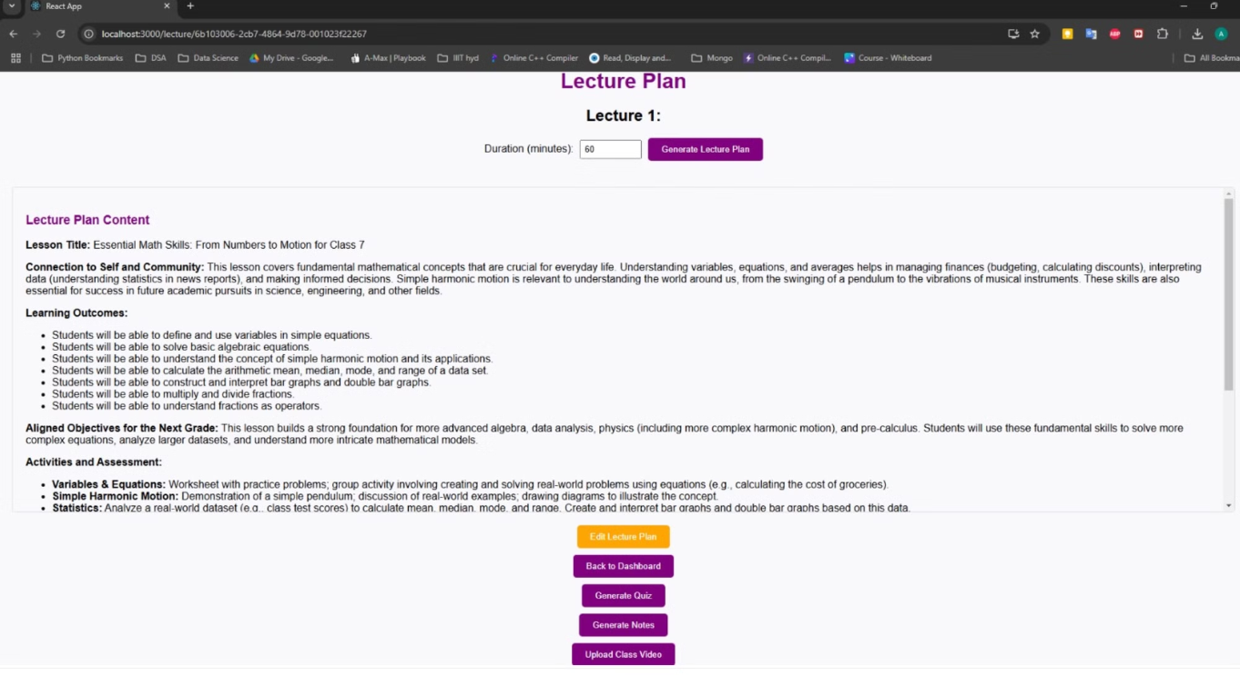
Lesson Plan Generator

Slide 12
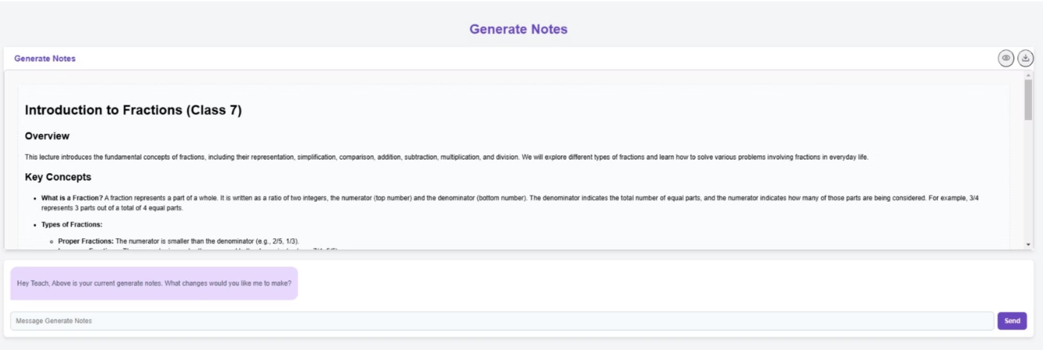
Lecture Notes Generator

Slide 13
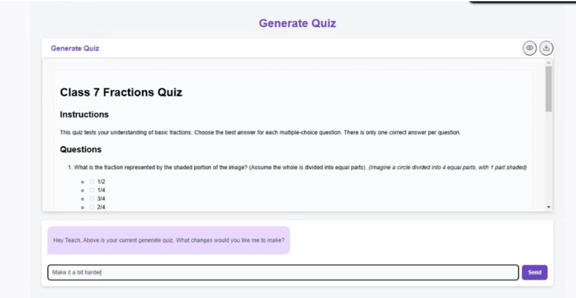
Quiz Generation

Slide 14
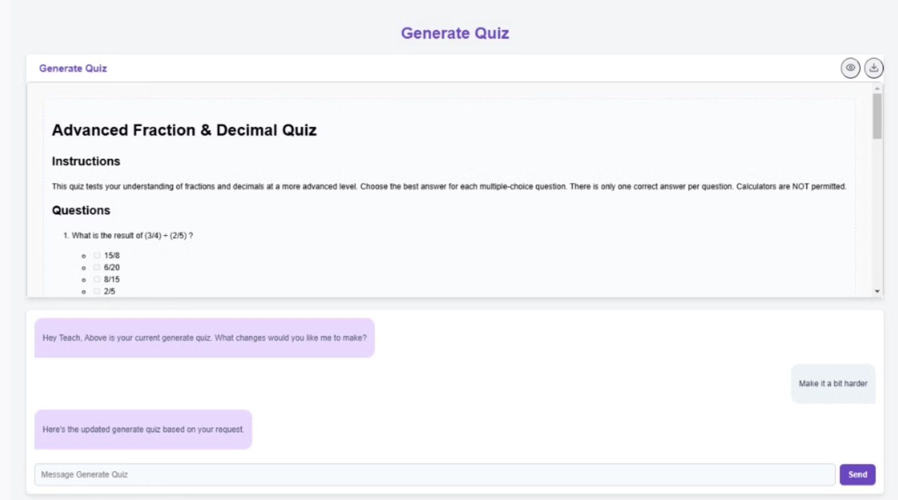
Quiz Generation (cont…)

Slide 15
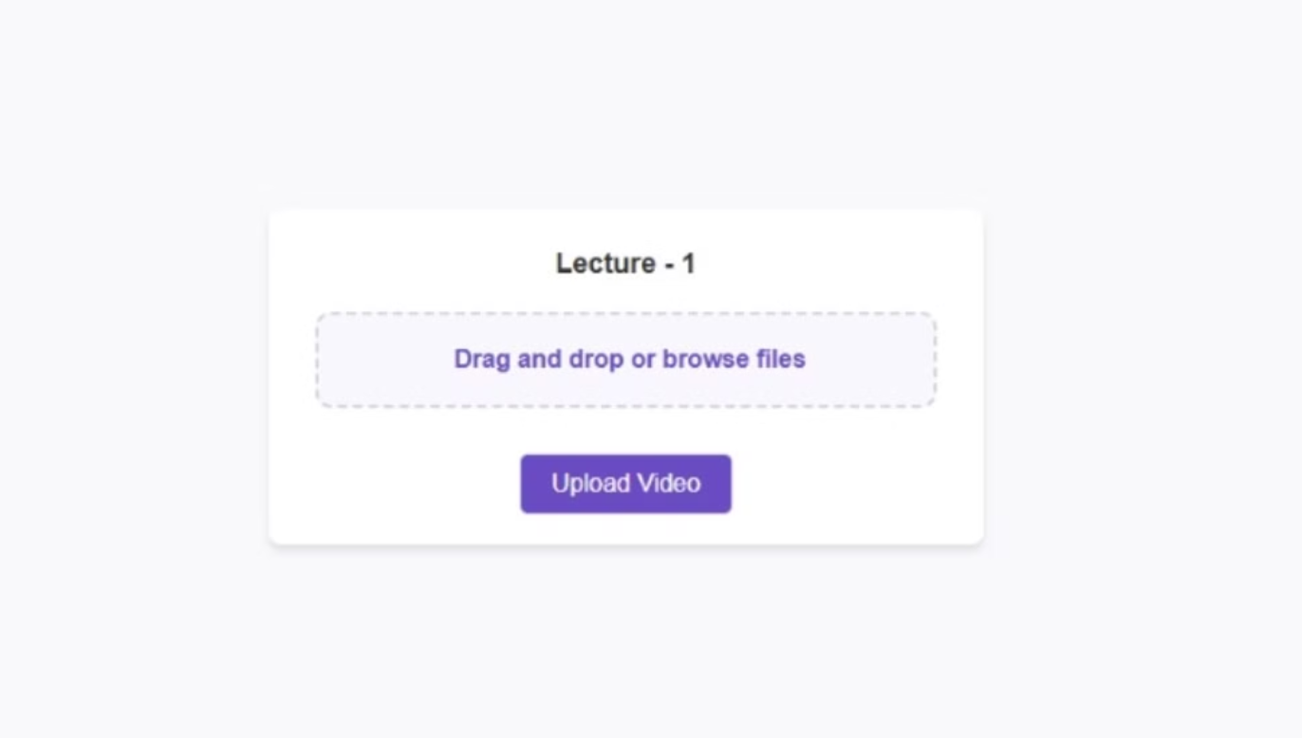
Video Upload

Slide 16
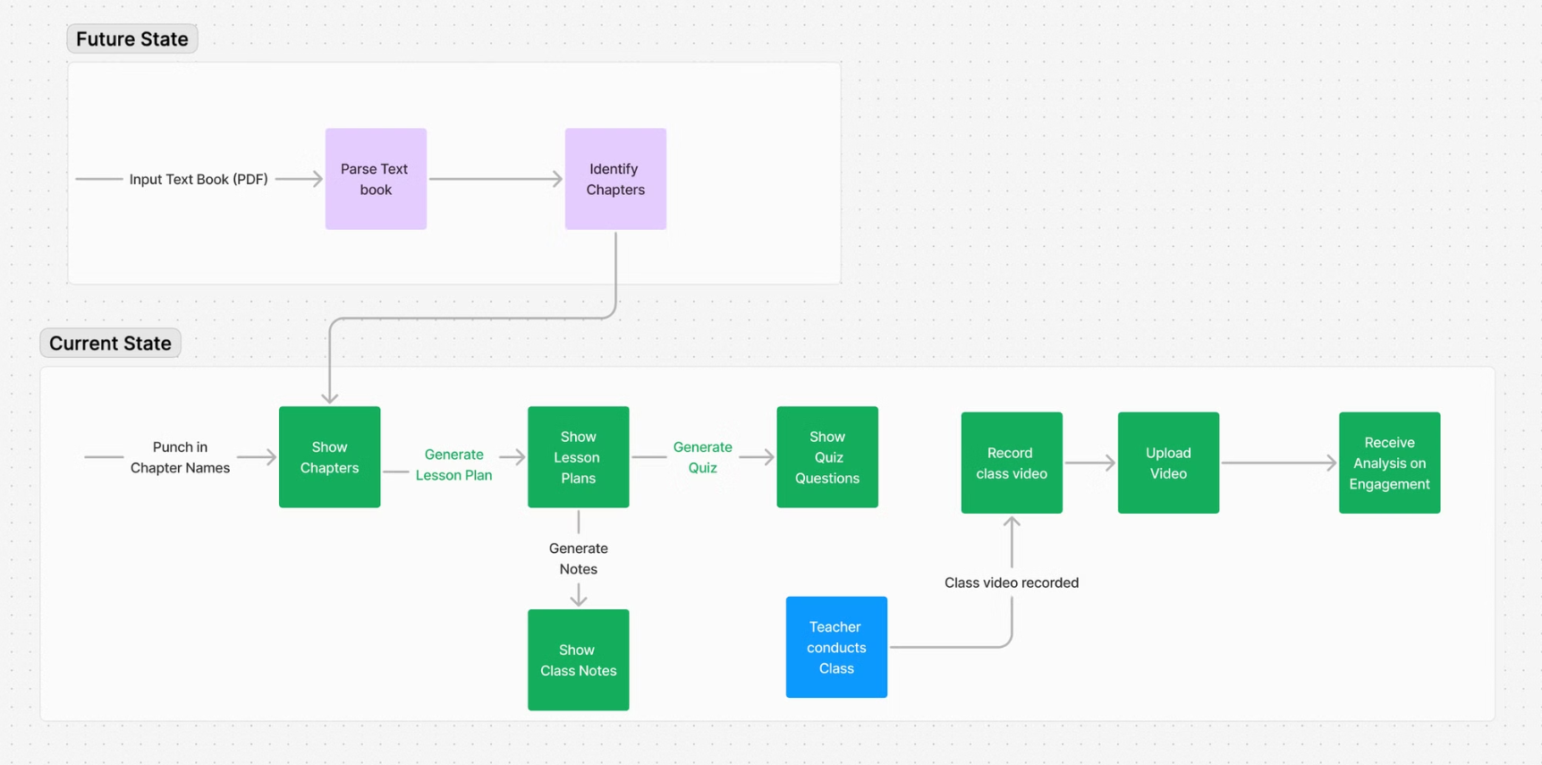

Slide 17
Tech Stack

Slide 18
Frontend
Backend
Database
Machine Learning
ClassLog's user interface is built using the ReactJS framework, ensuring a smooth and responsive user experience.
The backend of ClassLog is powered by the Flask Python web framework, enabling efficient and scalable data processing.
The application's data is securely stored in a MongoDB database, providing flexibility and scalability.
AI features are powered by Google Gemini
Transcript generation is done using OpenAI Whisper
Hand Raise Detection is implemented using OpenCV

Slide 19
Future Development Plans

Slide 20
PDF Support
Real-World Testing
Continuous Improvement
Upcoming updates will allow users to upload PDF lecture materials for seamless integration with ClassLog's features.
ClassLog will undergo extensive real-world testing to ensure it meets the evolving needs of educators and students.
Fine-tune AI models for enhanced accuracy and performance.

Slide 21
Questions ?

Slide 22
Thank You!!!

